Slide 1

Group 3
Bhavya Kuruba Nagaraj
Sreevani
GuruChandra
Daneil
DAV-6100-1:Insights into Chicago: Analyzing Crime and Education Trends

Slide 2
Agenda
Instructions:
Do not edit this slide
Overview
Project Requirements
Data Profile
Conceptual Architecture
Demo
Research questions
Team Responsibilities

Slide 3



Introduction to Datasets: Crime and Education in Chicago
Chicago Dataset:
Chicago Crime Dataset: Detailed records of reported crimes in Chicago, including unique identifiers, dates, locations, crime types, descriptions, and arrest information, providing insights into crime patterns and trends within the city.
Chicago School API Dataset: The Chicago school API dataset, available at https://data.cityofchicago.org/resource/dw27-rash.json, provides detailed information on educational institutions, including school IDs, names, demographics, and academic metrics, offering a comprehensive view of the city's education landscape. Merged Dataset: Combines information from both sources, linking reported crimes with nearby schools based on the address column, facilitating exploration of correlations between crime rates and educational institutions, enhancing understanding of societal dynamics and the impact of education on crime prevention and community safety in Chicago.
Yeshiva University | Katz School

Slide 4
Overview
The project agenda involves examining how various types of crimes impact schools in different neighborhoods. By analyzing the merged datasets, we aim to understand if certain crimes have a greater influence on schools depending on their location. This analysis will shed light on the relationship between crime patterns and educational institutions, informing strategies to address safety concerns and support schools in diverse areas.
Yeshiva University | Katz School

Slide 5
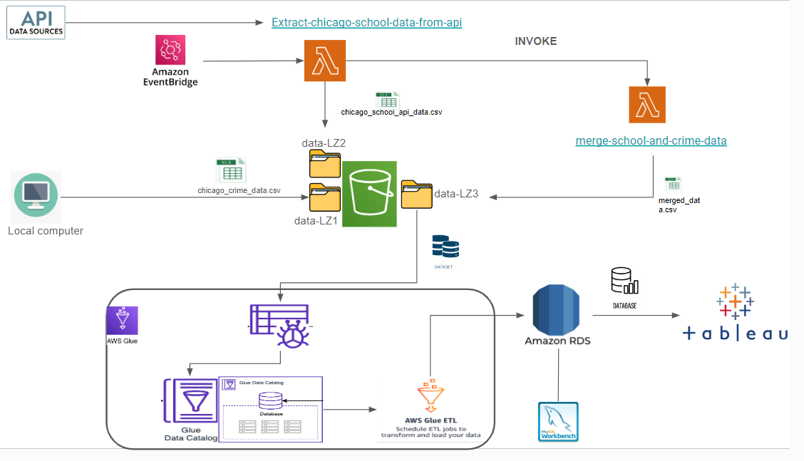
Project Architecture
Yeshiva University | Katz School

Slide 6

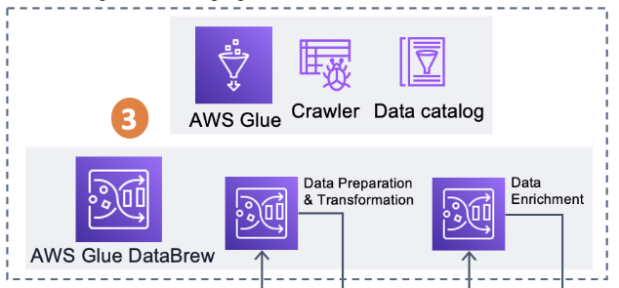



AWS Service Overview
Amazon S3: A scalable storage solution for collecting and storing large volumes of data.
AWS Glue DataBrew: A tool for visually preparing data for analysis without coding.
AWS Glue Crawler: Automatically discovers and categorizes data by creating metadata.
Amazon QuickSight: A business intelligence service for creating visualizations and dashboards.
Lamda Function:
RDS:
Yeshiva University | Katz School

Slide 7
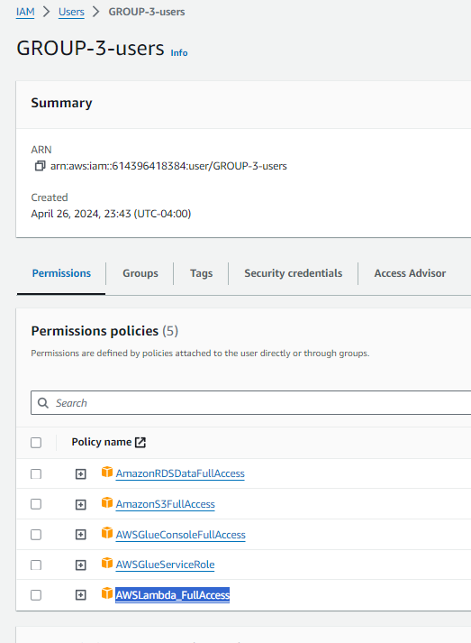
Creating neccecery permissions for the project using IAM
Yeshiva University | Katz School

Slide 8

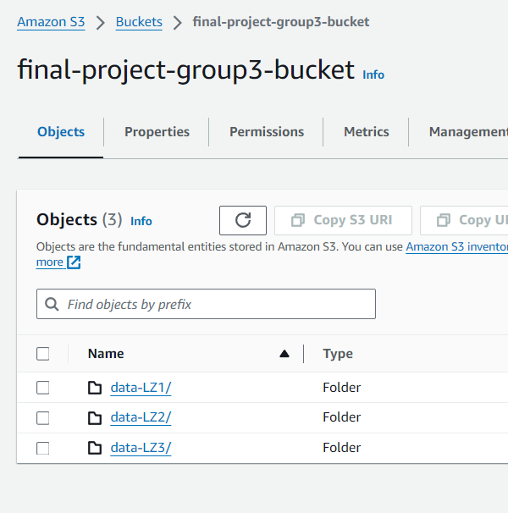
Storing Data in s3 by creating landing zones
Chicago crime data will be saved to the data-LZ1
Chicago school api will be saved to data-lz2
Merged data will be saved to data-LZ3
Yeshiva University | Katz School

Slide 9

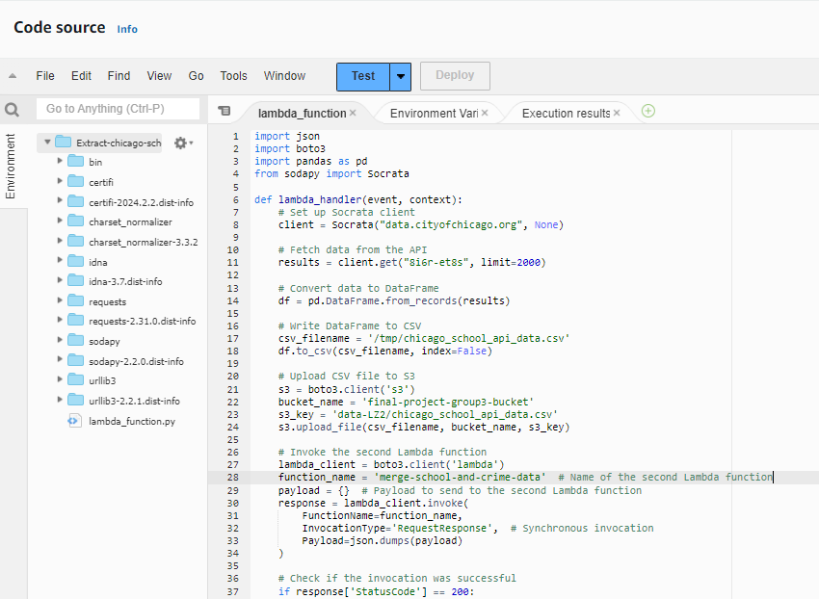
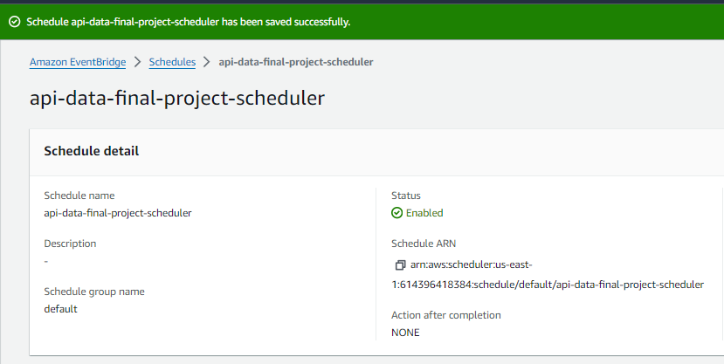
Creating Event scheduler and Lambda
Creating event scheduler for triggering the lambda function.
We have used 2 lambda functions one for getting the school api data and another for merging and loading merged data to landing zone 3.
Yeshiva University | Katz School

Slide 10
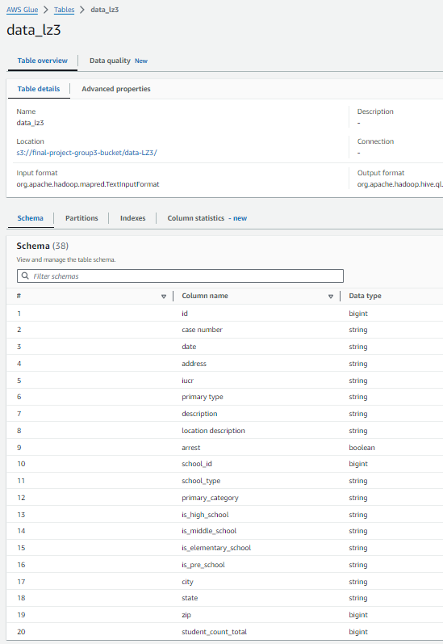
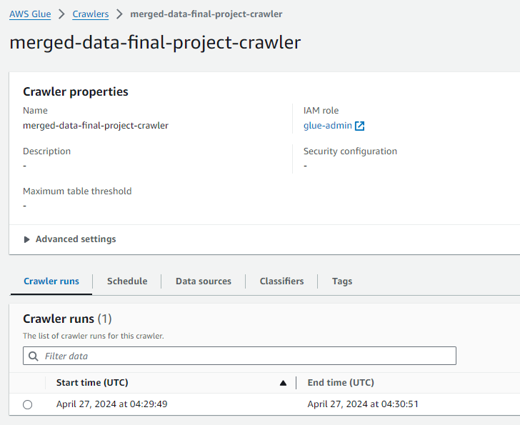
Creating Glue crawler to Extract the data from s3
We have created the crawler to get data from s3 to glue catalog database for the further transformations.
Yeshiva University | Katz School

Slide 11
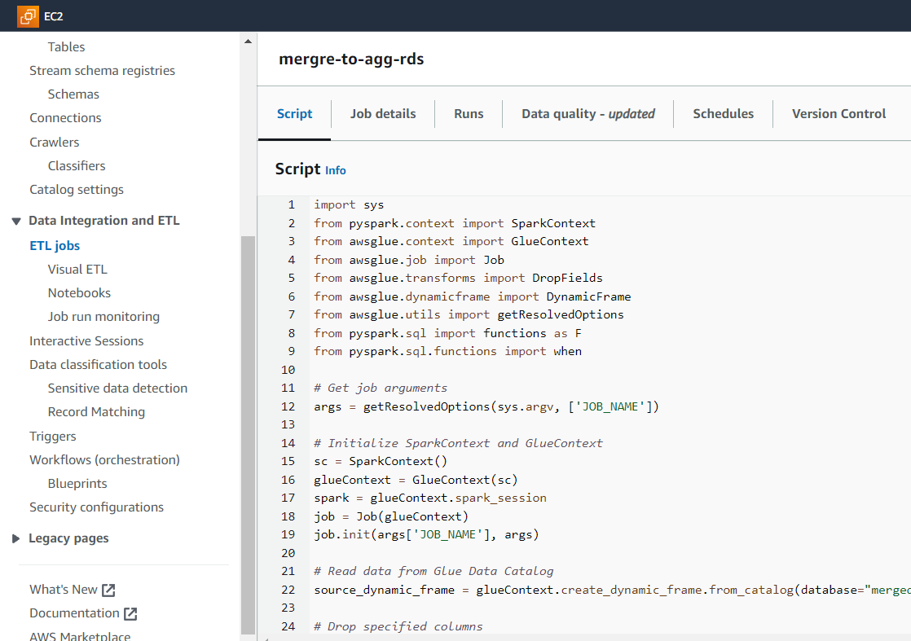
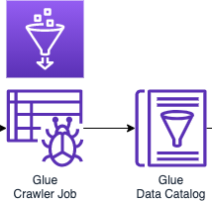
Creating Glue ETL script to load data to RDS
In this we have created a ETL job which moves the data from AWS glue catalog to RDS data base once we run our job
Yeshiva University | Katz School

Slide 12

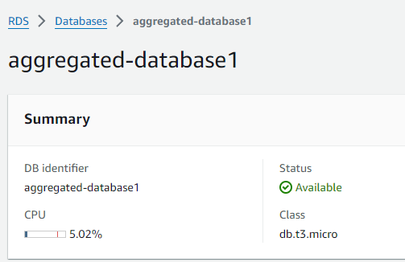
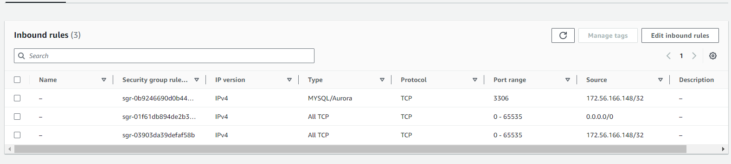
Created RDS for storing data from ETL
We created RDS instance to store the data coming from glue ETL process.
Provided necessary security policies with proper credentials for the usage.
Yeshiva University | Katz School

Slide 13

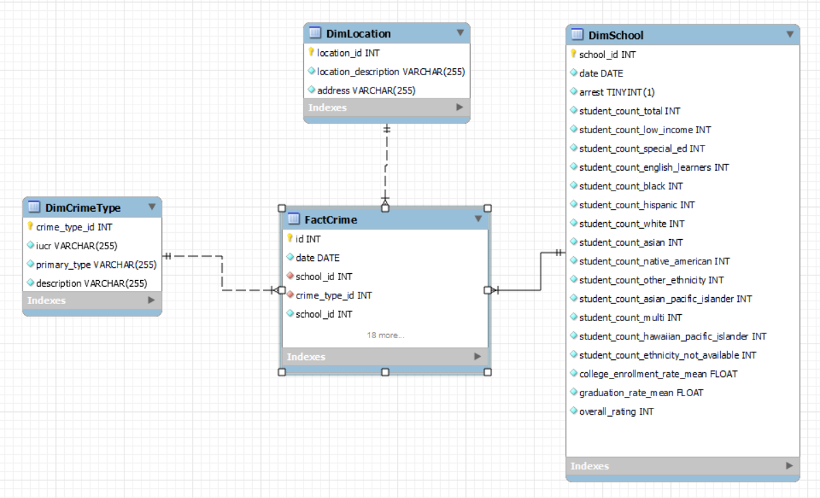
Warehouse solutions
Created facts and dimension tables and dimensional model.
Used stored procedure to move data from main table to warehouse
Yeshiva University | Katz School

Slide 14

Visualization using Tableau
Performed visualization using Tableau by importing data from RDS and creating dashboards.
Created visualizations to answer the research questions
Yeshiva University | Katz School

Slide 15
Research questions
Correlation between Crime Types and Locations there a correlation between the type of location (residential, commercial, educational) and specific crime types?
Which addresses or areas have the highest and lowest graduation rates?
Are certain crimes more prevalent in areas with higher concentrations of low-income students?
Crime Composition Analysis What are the most common types of crimes committed?
How do graduation rates vary among educational institutions in different areas of Chicago?
What are the patterns and trends in arrest rates across major Chicago streets, and what factors might influence these arrest disparities?
What seasonal or monthly trends exist in the number of arrests in Chicago, and what might be the underlying causes for these variations?
Yeshiva University | Katz School

Slide 16
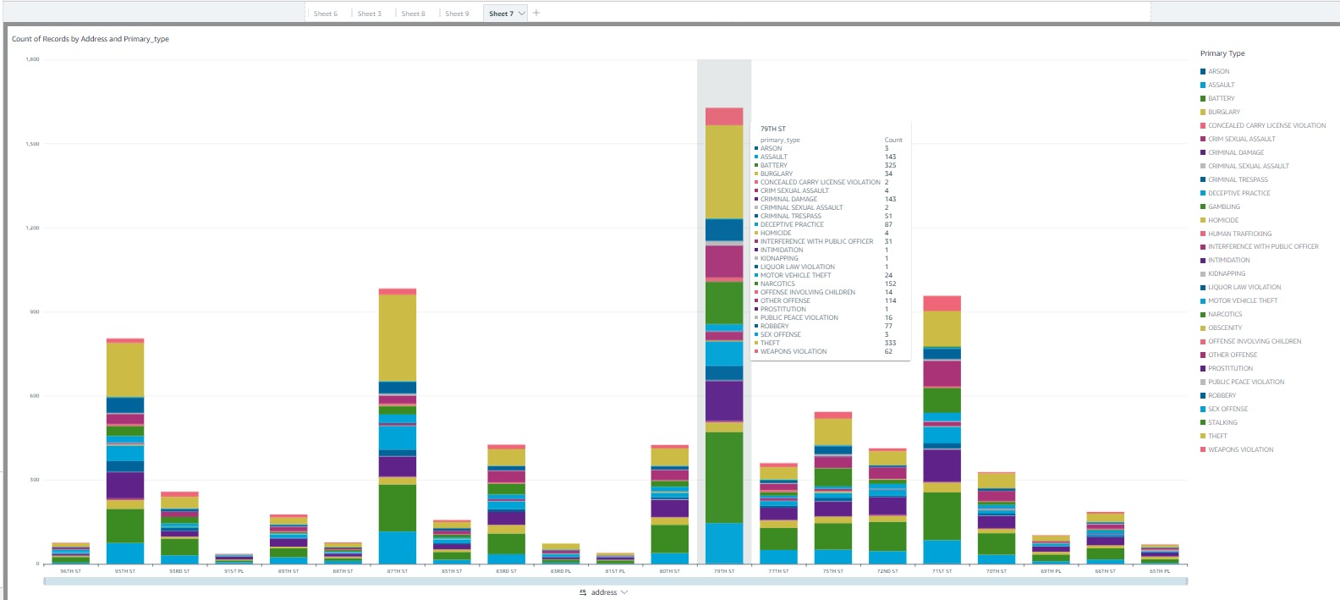
Research questions
Correlation between Crime Types and Locations there a correlation between the type of location (residential, commercial, educational) and specific crime types?
Yeshiva University | Katz School

Slide 17
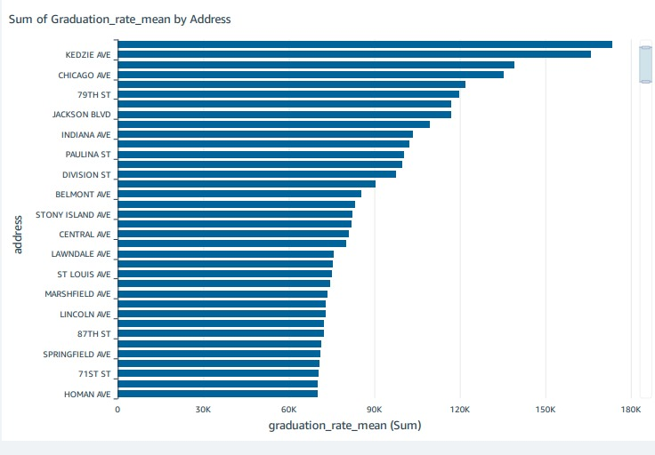
Research questions
Which addresses or areas have the highest and lowest graduation rates?
Yeshiva University | Katz School

Slide 18
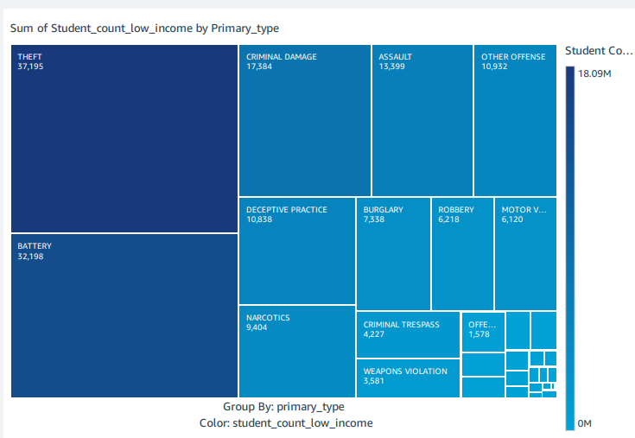
Research questions
Are certain crimes more prevalent in areas with higher concentrations of low-income students?
Yeshiva University | Katz School

Slide 19
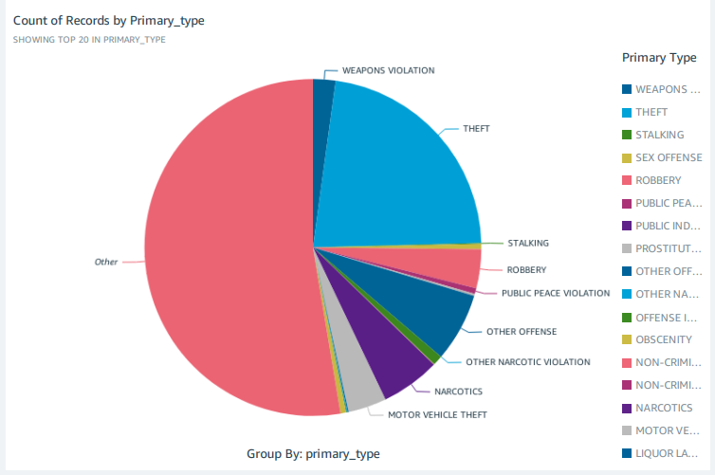
Research questions
Crime Composition Analysis What are the most common types of crimes committed?
Yeshiva University | Katz School

Slide 20
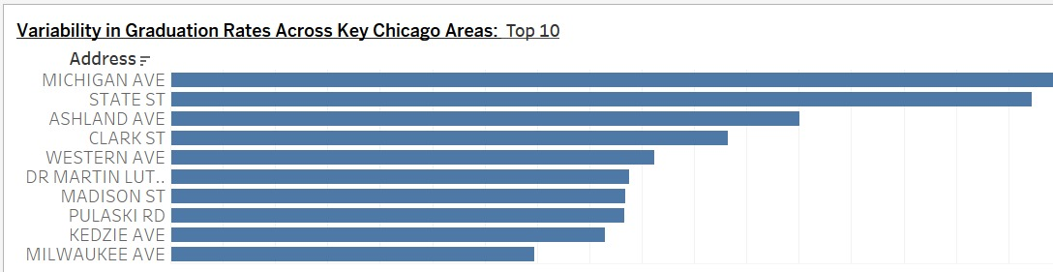
Research questions
How do graduation rates vary among educational institutions in different areas of Chicago?
Yeshiva University | Katz School

Slide 21
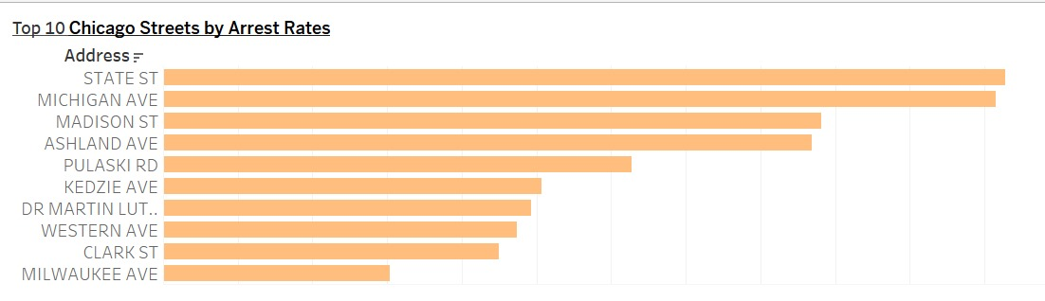
Research questions
What are the patterns and trends in arrest rates across major Chicago streets, and what factors might influence these arrest disparities?
Yeshiva University | Katz School

Slide 22
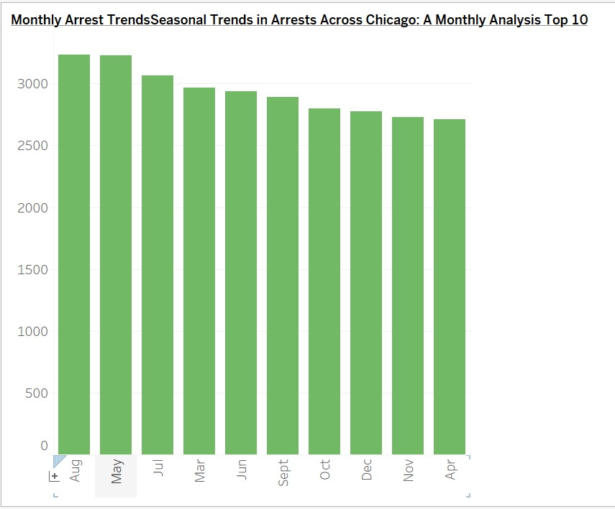
Research questions
What seasonal or monthly trends exist in the number of arrests in Chicago, and what might be the underlying causes for these variations?
Yeshiva University | Katz School

Slide 23
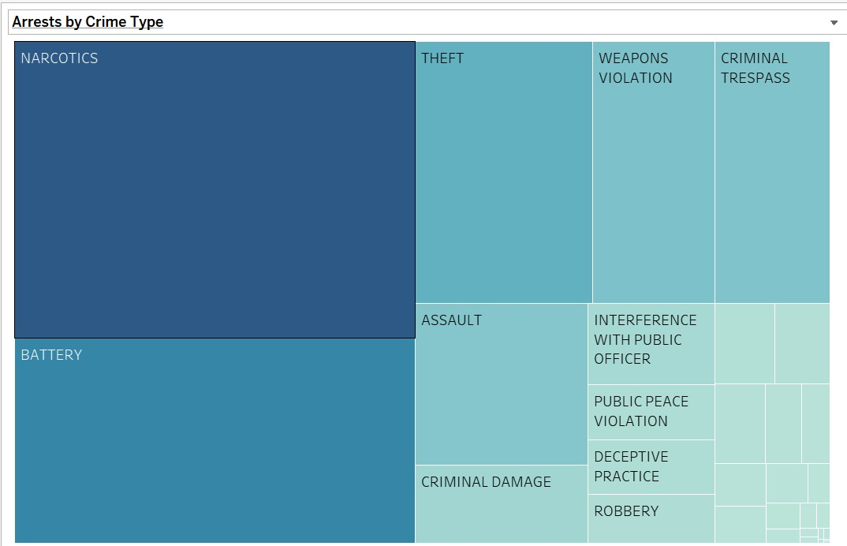
Research questions
How do arrest proportions for different crime categories in Chicago reflect law enforcement focus or community crime patterns, and how have these proportions changed over time?
Yeshiva University | Katz School

Slide 24
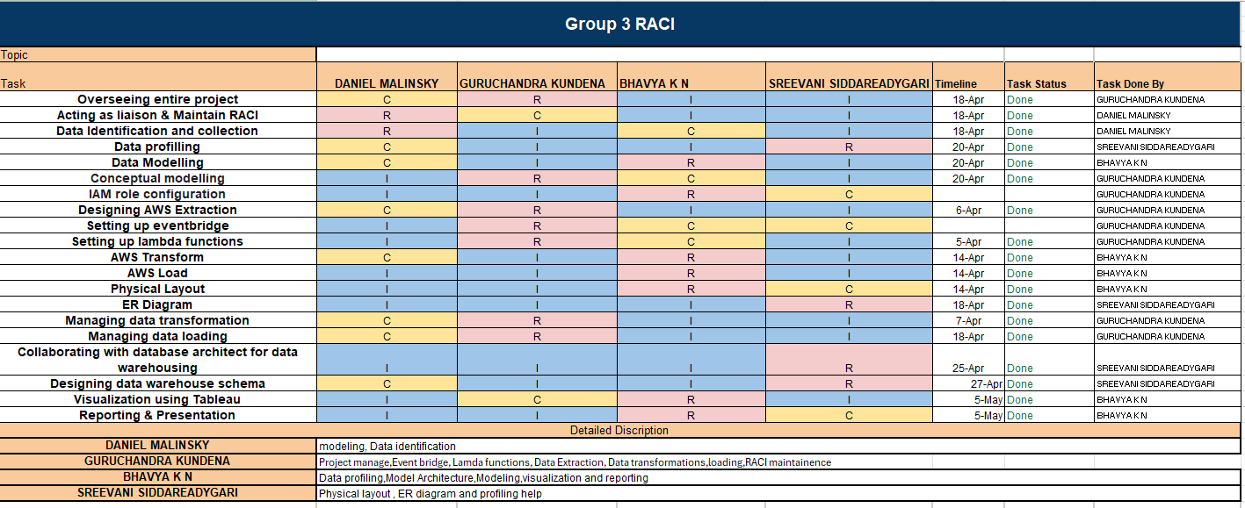
Team responsibilities and timeline
Yeshiva University | Katz School

Slide 25


